Slide 1
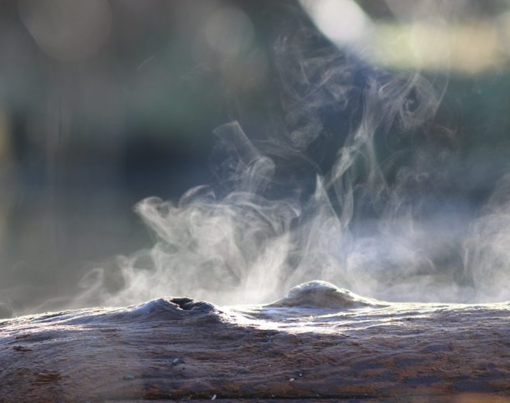
Structural Similarity in inverse problems
Why working together is better.
By: Teun Schilperoort

Slide 2
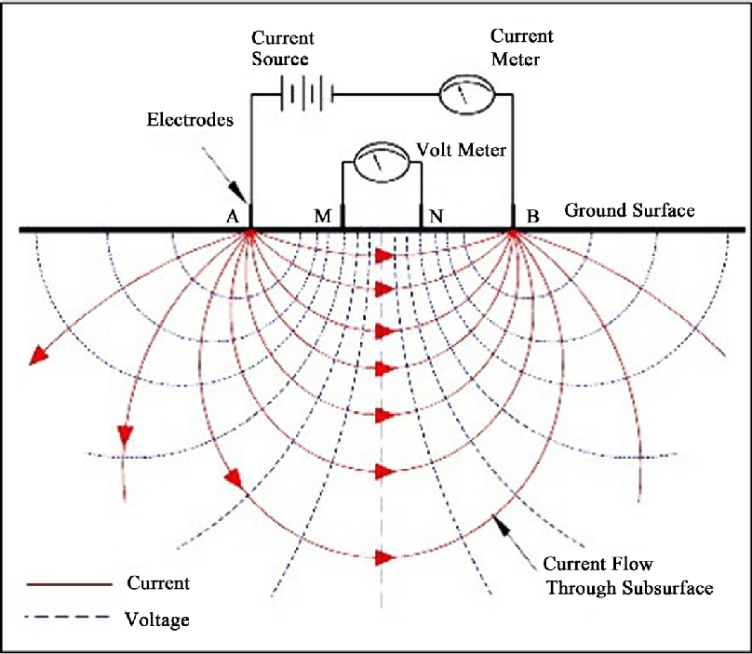
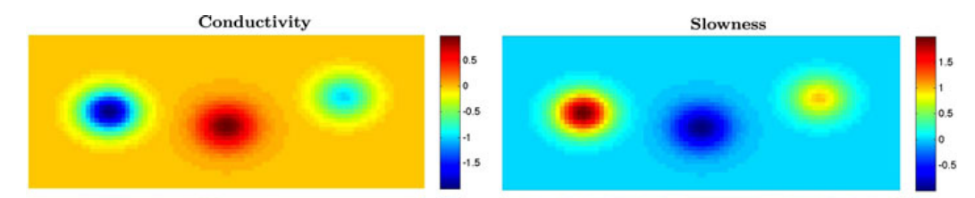
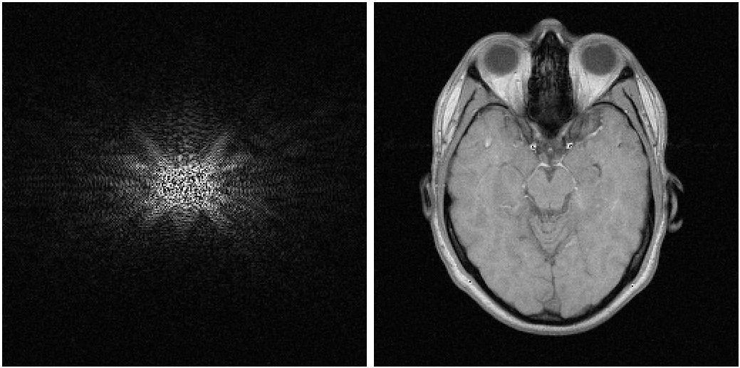
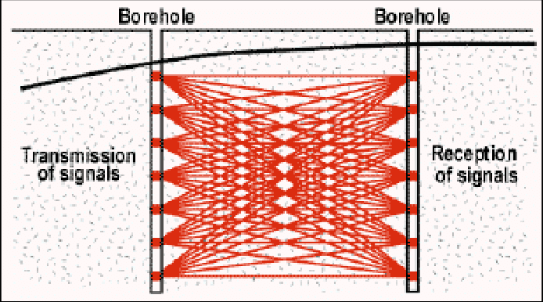
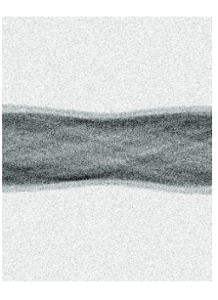
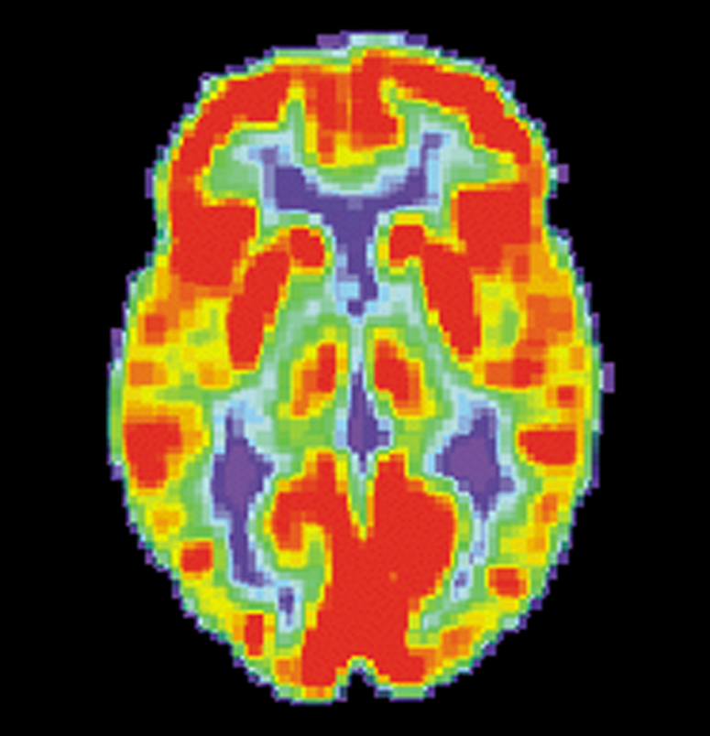
Geophysical Surveying
Medical Imaging
DC Conductivity
MRI scan
Borehole Tomography
PET scan

Slide 3
Inverse problems
System
Forward
Data
Inverse
“Infer model parameters from relevant observations”
Deconvolution, determining coefficients in ODE/PDE’s, seismographic imaging, MRI scans
In practice:
Ill-posed: No (unique) solution
Ill-conditioned: Small perturbations lead to large errors
Noisy data

Slide 4
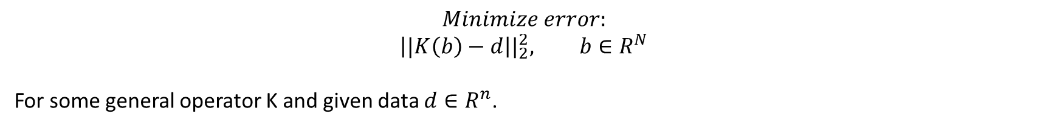
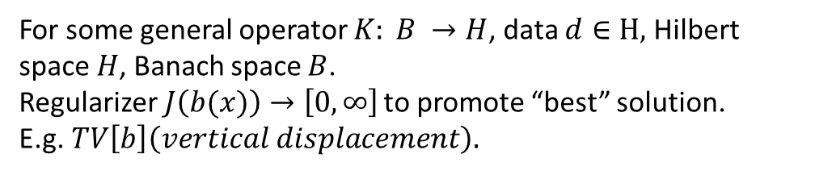

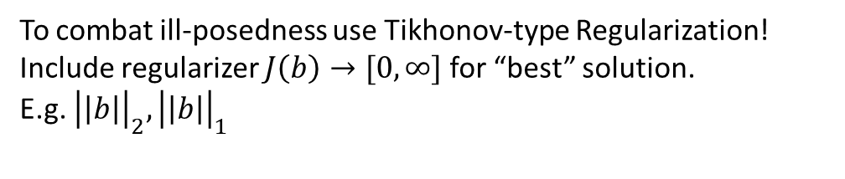
Variational optimalization
$$Minimize error:$$
$$\left||K\left(b\right)−d\right||_{2}^{2}, b∈R^{N}$$
For some general operator K and given data $d∈R^{n}$.
To combat ill-posedness use Tikhonov-type Regularization!
Include regularizer $J\left(b\right)→[0, ∞]$ for “best” solution.
E.g. ${\left|\left|b\right|\right|}_{2},{\left|\left|b\right|\right|}_{1}$
$$Minimize error:$$
$${{\left||K\left(b\left(x\right)\right)−d|\right|}^{2}}_{H}+J(b), b\left(x\right)∈B$$
For some general operator $K: B →H$, data $d∈H,$ Hilbert space $H$, Banach space $B$.
Regularizer$J\left(b(x)\right)→\left[0, ∞\right]$ to promote “best” solution.
E.g.$TV\left[b\right]\left(vertical displacement\right).$

Slide 5
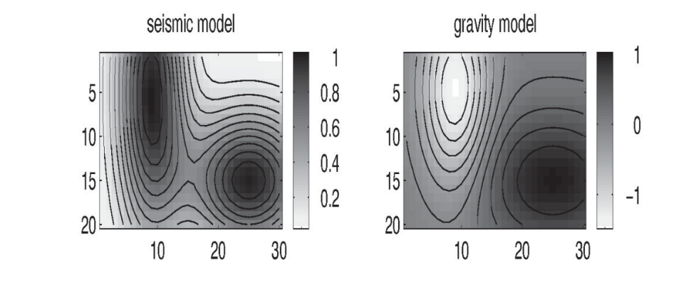
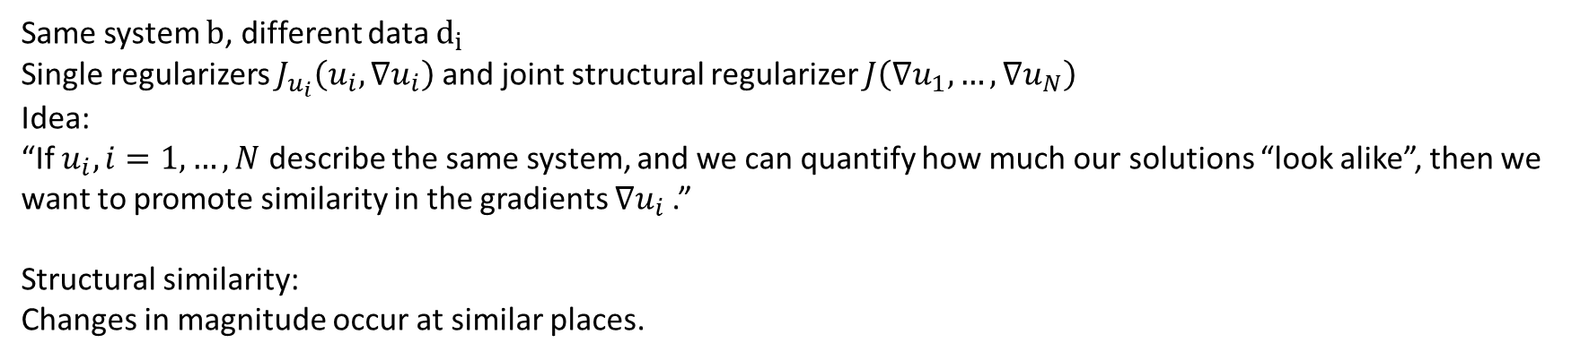
Joint inverse problems
Minimize over
$$\sum_{i=1}^{N}{{\left|\left|K_{i}\left(u_{i}\right)−d_{i}\right|\right|}_{ℋ_{𝒾}}^{2}}+J_{u_{i}}(u_{i}, ∇u_{i})+J\left(∇u_{1},…,{∇u}_{N}\right),u_{i}∈ℬ_{𝒾}$$
$$b≔\left(u_{1},…,u_{N}\right)∈ℬ$$
Same system $b$, different data $d_{i}$
Single regularizers $J_{u_{i}}\left(u_{i}, ∇u_{i}\right)$ and joint structural regularizer $J\left(∇u_{1},…, ∇u_{N}\right)$
Idea:
“If $u_{i}, i=1, …, N$ describe the same system, and we can quantify how much our solutions “look alike”, then we want to promote similarity in the gradients $∇u_{i}$.”
Structural similarity:
Changes in magnitude occur at similar places.
Haber, Holtzmann Gazit(1997)
Haber, Oldenburg(1997)

Slide 6


Joint regularizer
$$J\left(u_{1},…,u_{N}\right)≔\int_{Ω}{f\left(x,u_{1}\left(x\right),…,u_{N}\left(x\right),∇u_{1}\left(x\right),…,∇u_{N}\left(x\right)\right)dx},Ω⊂R^{n}$$
$$J\left({∇u}_{1},…,{∇u}_{N}\right)≔\int_{Ω}{f\left(∇u_{1}\left(x\right),…,∇u_{N}\left(x\right)\right)dx},Ω⊂R^{n}$$
Quantify similarity of vectors $∇u_{1},…,∇u_{N}$.
Non-trivial even for $N = 2$.
Dot-product
$$f\left(∇u_{1}, ∇u_{2}\right)={\left( ∇u_{1}⋅∇u_{2}\right)}^{2}=\left|∇u_{1}\right|\left|∇u_{2}\right|\cos\left(θ\right)$$
Cross-gradient (CG)
$$f\left(∇u_{1},∇u_{2}\right)={\left|∇u_{1}×∇u_{2}\right|}^{2}={\left|\left|∇u_{1}\right|\right|}^{2}{\left|\left|∇u_{2}\right|\right|}^{2}−{\left(∇u_{1}⋅∇u_{2}\right)}^{2}$$
Gradient difference (GD)
$$f\left(∇u_{1}, ∇u_{2}\right)={\left(∇u_{1}−∇u_{2}\right)}^{2}$$
$$f\left(∇u_{1},∇u_{2}\right)= \sum_{i}{σ_{i}{\left(\left[∇u_{1},∇u_{2}\right]\right)}^{p}}$$
Schatten p matrix norm
We want general conditions on $f\left(…\right)$!!

Slide 7
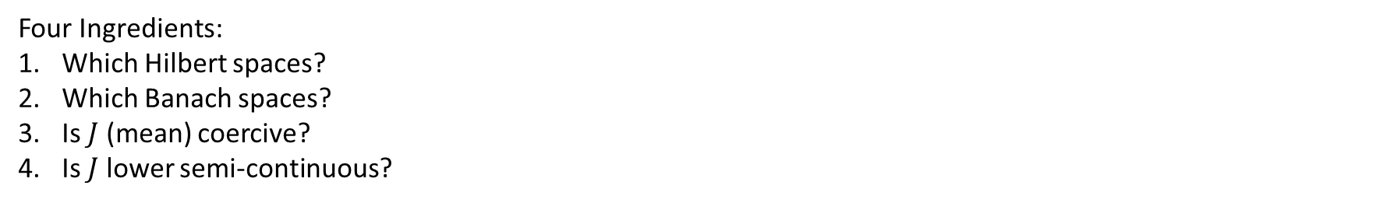
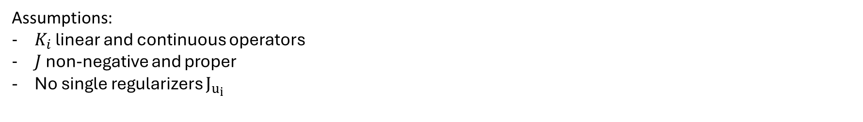


Well-posedness
Minimize over
$$\sum_{i=1}^{N}{{\left|\left|K_{i}\left(u_{i}\right)−d_{i}\right|\right|}_{ℋ_{𝒾}}^{2}}+J\left(∇u_{1},…,{∇u}_{N}\right),u_{i}∈ℬ_{𝒾}$$
$$b≔\left(u_{1},…,u_{N}\right)∈ℬ$$
Four Ingredients:
Which Hilbert spaces?
Which Banach spaces?
Is $J$ (mean) coercive?
Is $J$ lower semi-continuous?
$$ℋ=⨁{H_{i}}$$
$$ℬ=⨁{B_{i}}$$
Assumptions:
$K_{i}$ linear and continuous operators
$J$ non-negative and proper
No single regularizers $J_{u_{i}}$

Slide 8
1. Which Hilbert space?

Slide 9

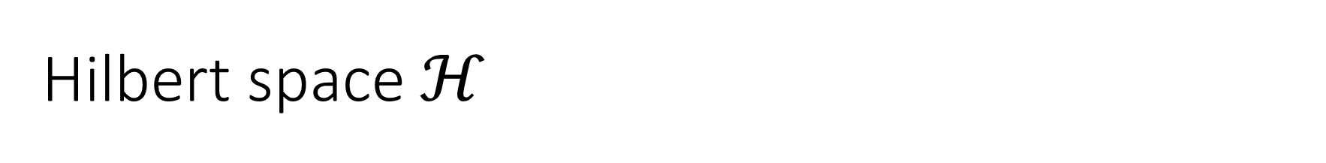
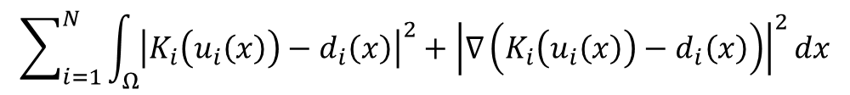

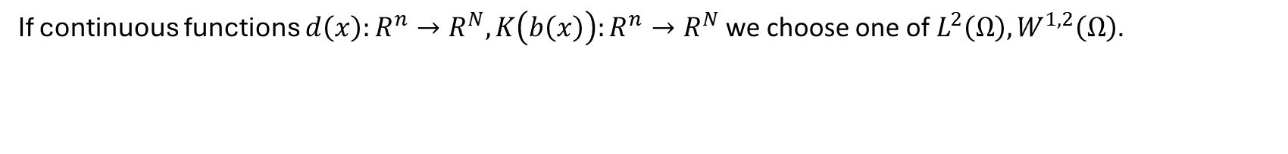
Hilbert space $ℋ$
The norm between observed data $d=\left(d_{1},…,d_{N}\right)$ and system prediction $K\left(b\right)$ in the data fidelity term
$${\left|\left|K\left(b\right)−d\right|\right|}_{ℋ}^{2}$$
If continuous functions $d\left(x\right):R^{n}→R^{N},K\left(b\left(x\right)\right):R^{n}→R^{N}$ we choose one of $L^{2}\left(Ω\right),W^{1,2}\left(Ω\right)$.
$$\sum_{i=1}^{N}{\int_{Ω}{{\left|K_{i}\left(u_{i}\left(x\right)\right)−d_{i}\left(x\right)\right|}^{2}dx,}}$$
$$\sum_{i=1}^{N}{\int_{Ω}{{\left|K_{i}\left(u_{i}\left(x\right)\right)−d_{i}\left(x\right)\right|}^{2}+{\left|∇\left(K_{i}\left(u_{i}\left(x\right)\right)−d_{i}\left(x\right)\right)\right|}^{2}dx}}$$
If discretized domain $Ω$, with points $x_{j},j=1,…,K$ we can take $ℋ=R^{NK}$.
$$\sum_{i=1}^{N}{\sum_{j=1}^{K}{\left|K_{i}\left(u_{i}\left(x_{j}\right)\right)\right.}}−d_{i}{\left.\left.\left(x_{j}\right)\right.\right|}^{2}$$

Slide 10
2. Which Banach space?

Slide 11
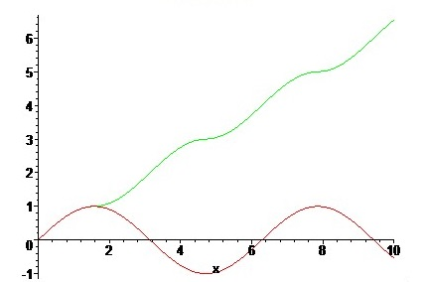
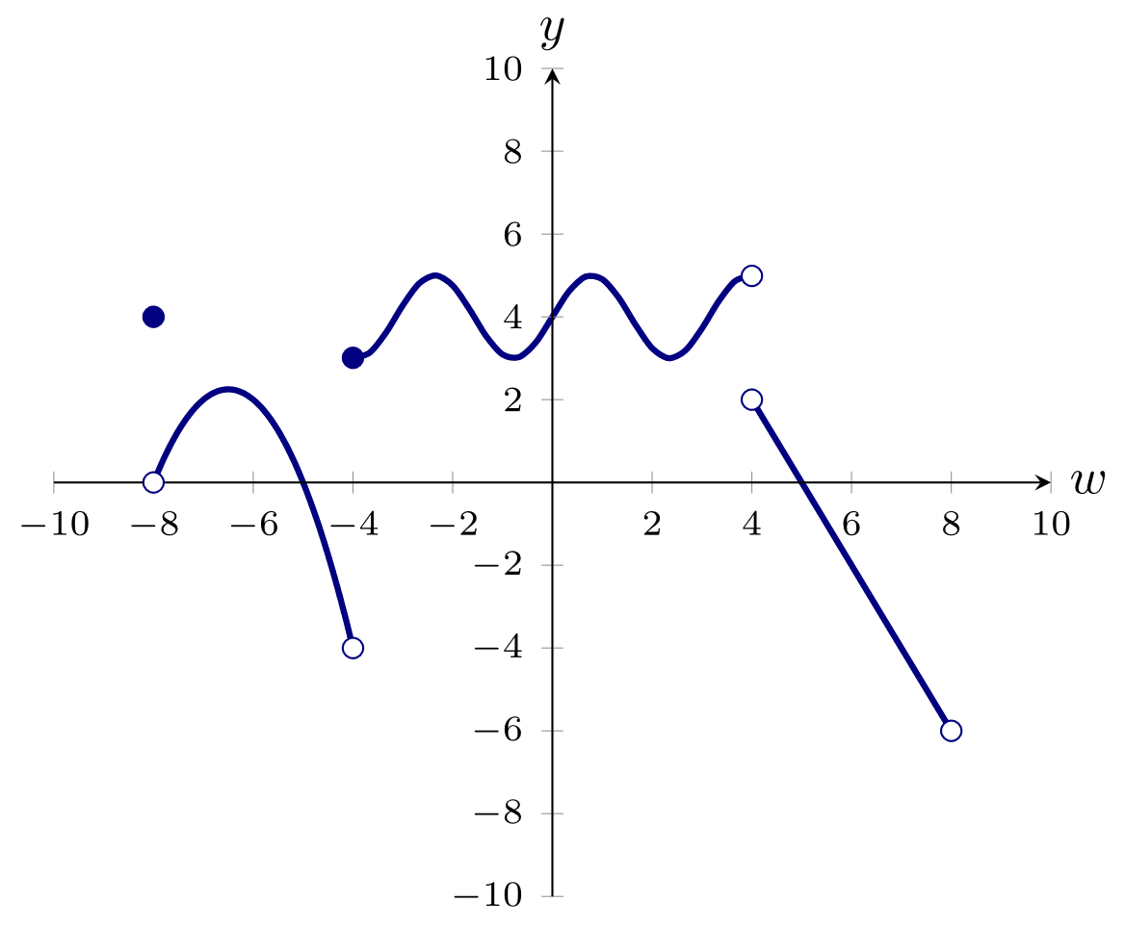
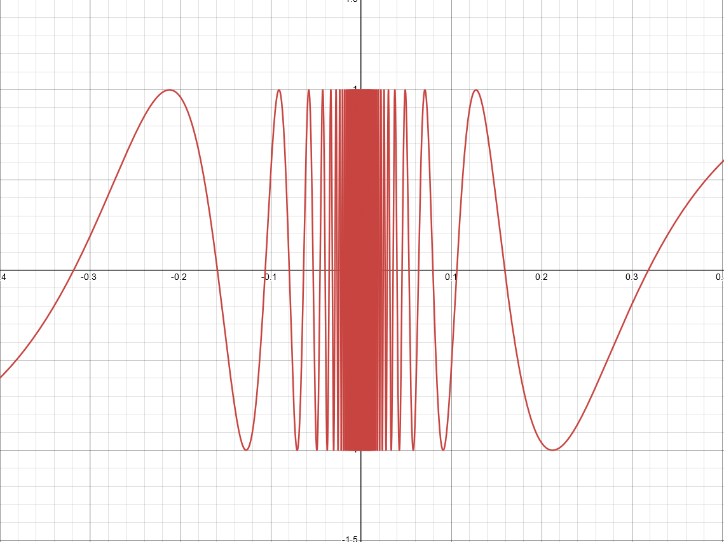
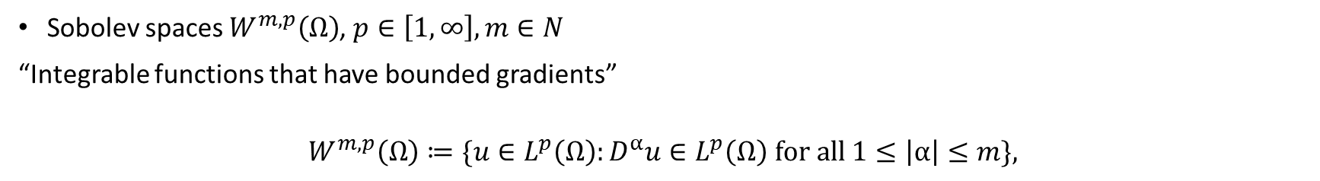
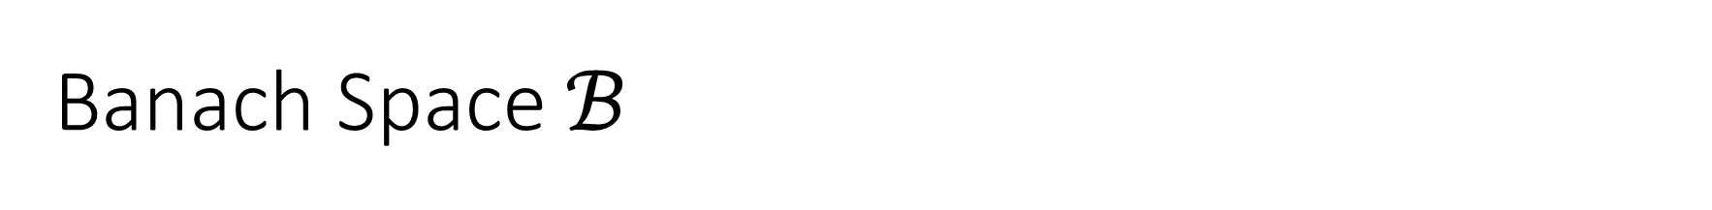

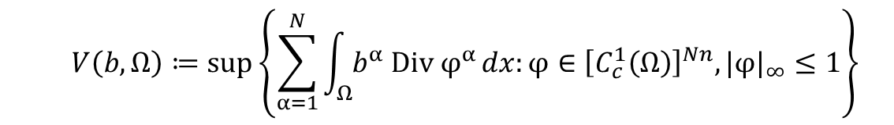
Banach Space $ℬ$
Sobolev spaces $W^{m,p}\left(Ω\right)$, $p∈\left[1,∞\right], m∈N$
“Integrable functions that have bounded gradients”
$$W^{m,p}\left(Ω\right)≔\{u∈L^{p}\left(Ω\right):D^{α}u∈L^{p}\left(Ω\right) \text{for} \text{all} 1≤\left|α\right|≤m\},$$
Functions of Bounded Variation (BV)
$$V\left(b,Ω\right)≔\sup\left\{\sum_{α=1}^{N}{\int_{Ω}{b^{α} \text{Div} φ^{α}}}dx:φ∈{\left[C_{c}^{1}\left(Ω\right)\right]}^{Nn},|φ|_{∞}≤1\right\}$$
$$V\left(b,Ω\right)< ∞$$
“Discontinuous functions with a derivative almost everywhere”

Slide 12
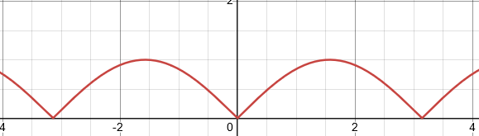
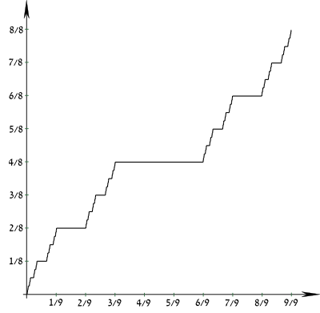
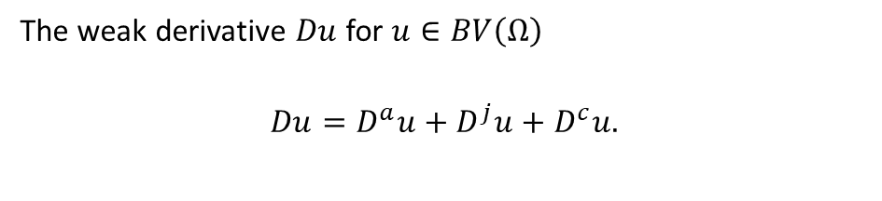

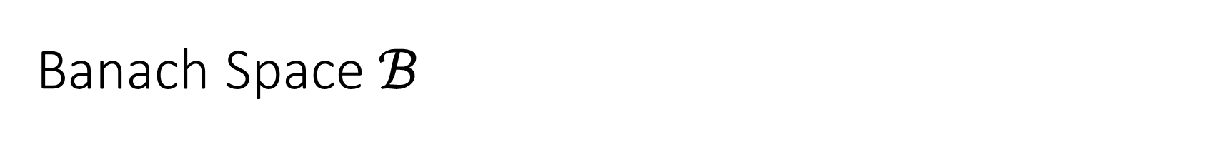

Banach Space $ℬ$
The weak derivative $Du$for $u∈BV\left(Ω\right)$
$$Du=D^{a}u+D^{j}u+D^{c}u.$$
The Absolutely continuous a.e “gradient”
$$D^{a}u≔∇u\left(x\right)ℒ^{𝓃}$$
The Jump part
$$D^{j}u\left(x\right)=\left(u^{+}\left(x\right)−u^{−}\left(x\right)\right)ℋ^{𝓃−1}$$
The Cantor part
$$D^{c}u$$
Special functions of bounded variation (SBV)
$$u∈BV\left(Ω\right), D^{c}u = 0$$
We take $ℬ={\left(SBV{\left(Ω\right)}^{N}\right)}^{′}⊂SBV{\left(Ω\right)}^{N}$ a proper subspace with additional topological properties.

Slide 13
3. Coercivity?

Slide 14
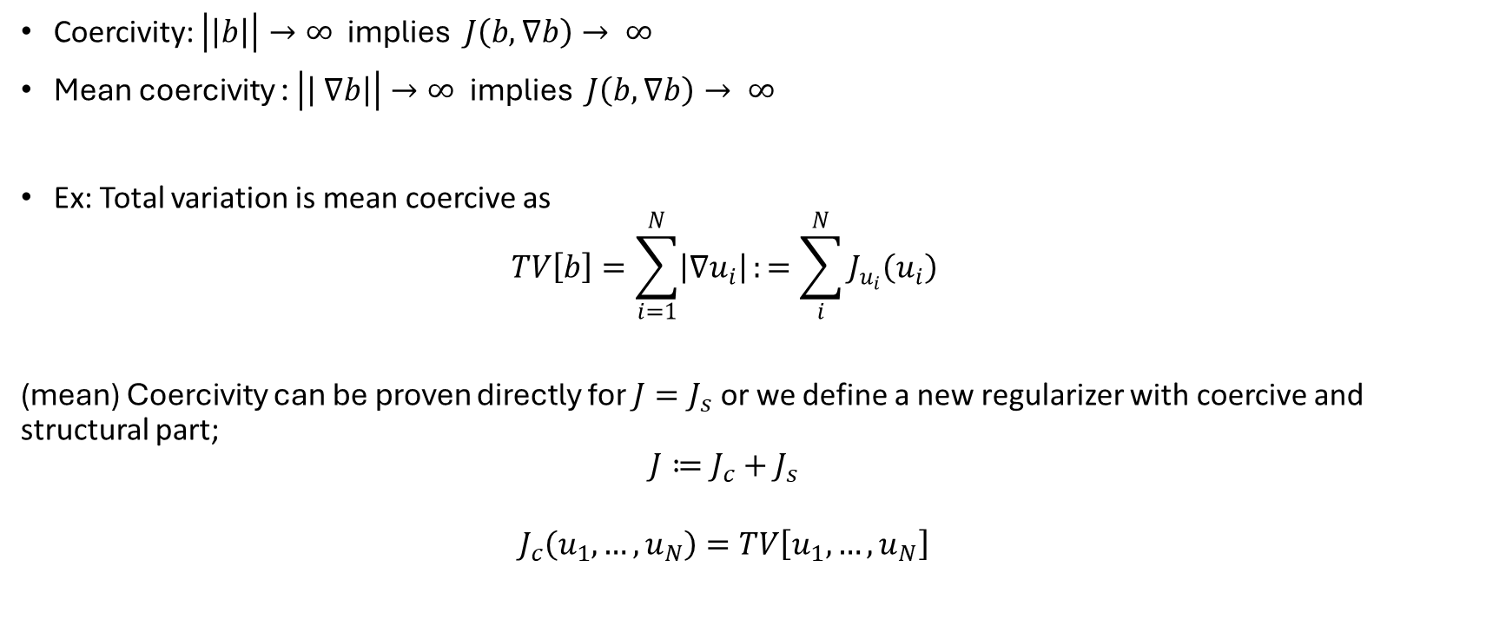
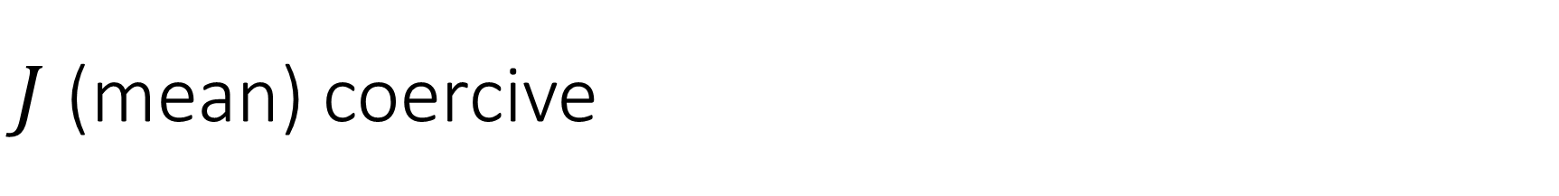
$J$ (mean) coercive
Coercivity: $\left|\left|b\right|\right|→∞$ implies $J\left(b,∇b\right)→ ∞$
Mean coercivity : $\left|\left| ∇b\right|\right|→∞$ implies $J\left(b,∇b\right)→ ∞$
Ex: Total variation is mean coercive as
$$TV\left[b\right]=\sum_{i=1}^{N}{\left|∇u_{i}\right|}:=\sum_{i}^{N}{J_{u_{i}}\left(u_{i}\right)}$$
(mean) Coercivity can be proven directly for $J=J_{s}$ or we define a new regularizer with coercive and structural part;
$$J≔J_{c}+J_{s}$$
$$J_{c}\left(u_{1},…,u_{N}\right)=TV\left[u_{1},…,u_{N}\right]$$

Slide 15
4. Lower semi-continuity?

Slide 16
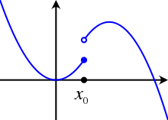
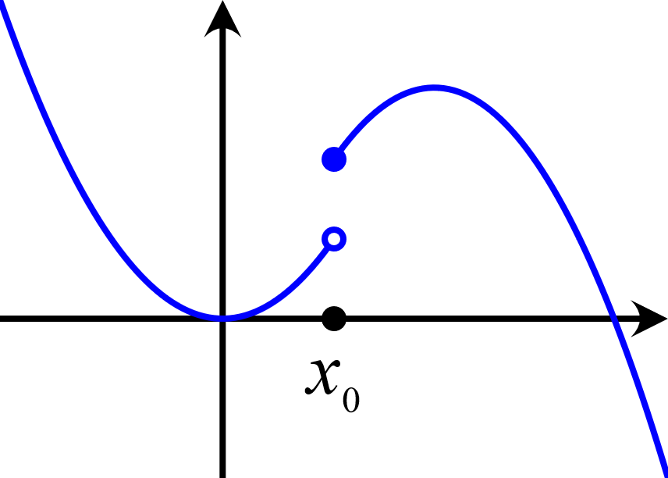
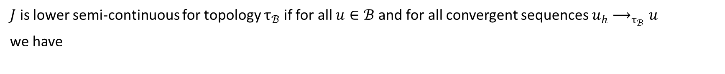
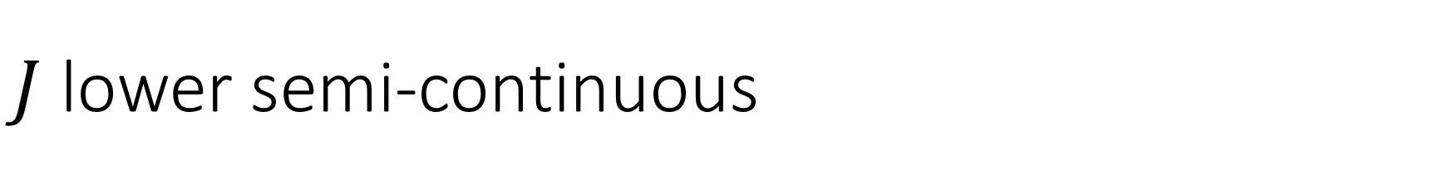
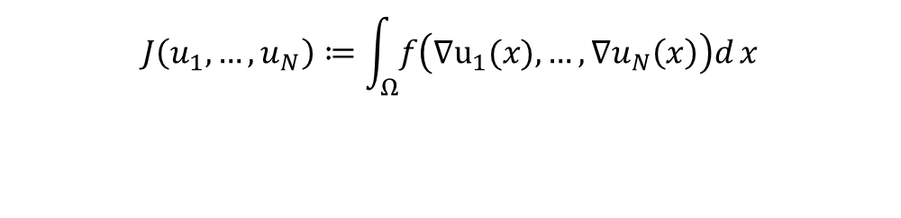
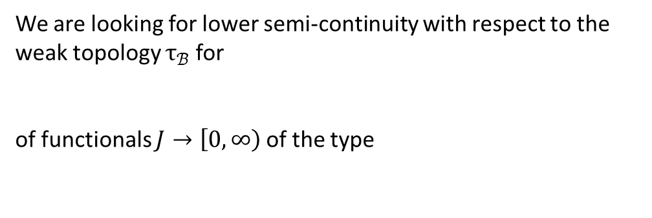
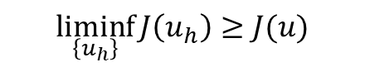
$J$ lower semi-continuous
$J$ is lower semi-continuous for topology $τ_{ℬ}$ if for all $u∈ℬ$and for all convergent sequences $u_{h}⟶_{τ_{ℬ}}u$
we have
$$\underset{\left\{u_{h}\right\}}{liminf}{J\left(u_{h}\right)}≥J(u)$$
We are looking for lower semi-continuity with respect to the weak topology $τ_{ℬ}$for
of functionals $J→\left[0,∞\right)$ of the type
$$ℬ={\left[W^{m,p}\left(Ω\right)\right]}^{N},{\left[BV\left(Ω\right)\right]}^{N},{\left[SBV\left(Ω\right)\right]}^{N}$$
$$J\left(u_{1},…,u_{N}\right)≔\int_{Ω}{f\left(∇u_{1}(x),…,∇u_{N}\left(x\right)\right)d}x$$
There are direct conditions on $f\left(∇u_{1}(x),…,∇u_{N}\left(x\right)\right)$ that guarantee this.
Called the Direct Method of the Calculus of Variations.

Slide 17
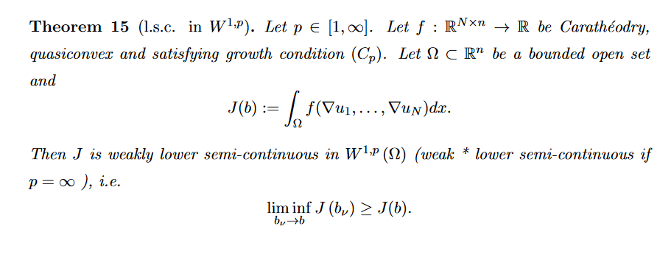
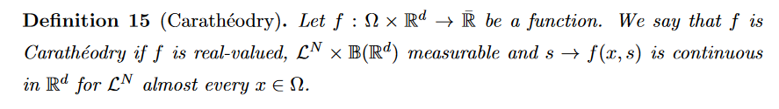
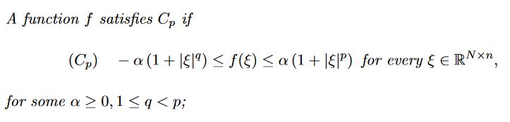
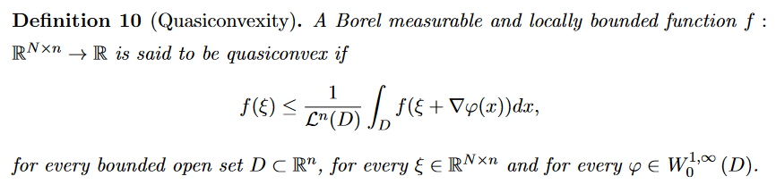

Slide 18
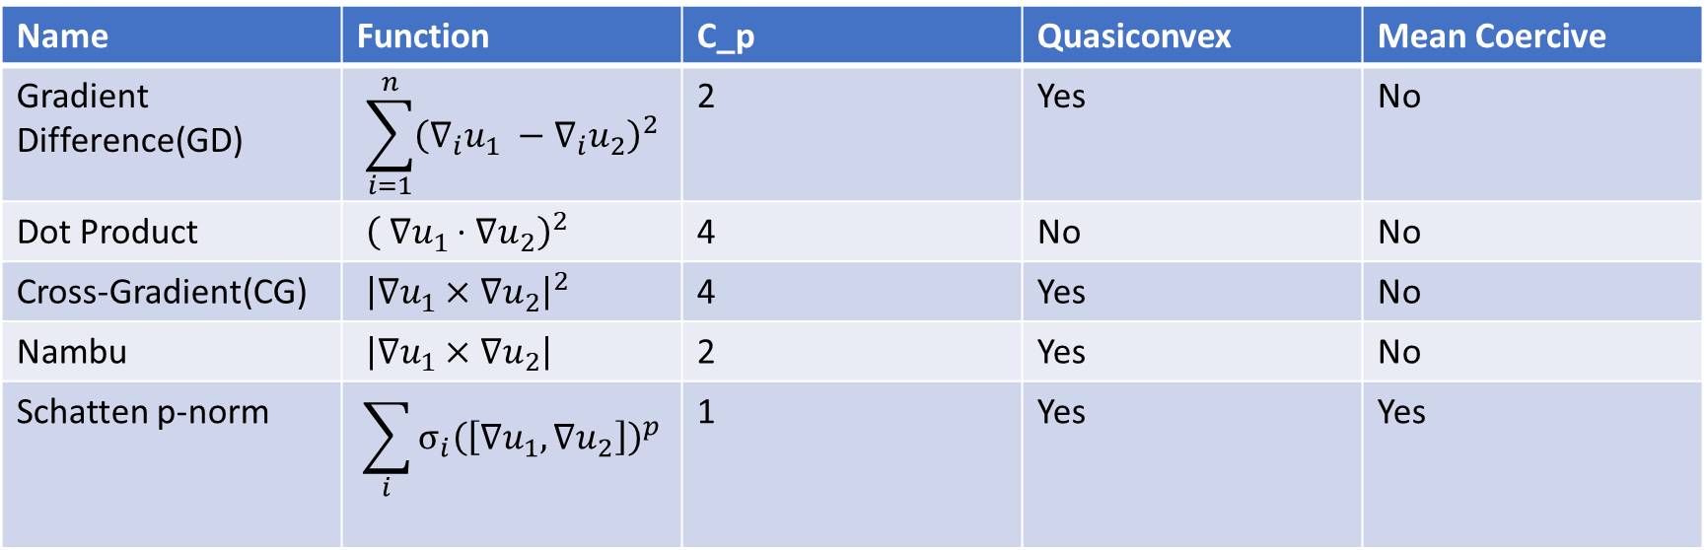
Specific Integrands
Name | Function | C_p | Quasiconvex | Mean Coercive
Gradient Difference(GD) | $$\sum_{i=1}^{n}{{\left(∇_{i}u_{1} −∇_{i}u_{2}\right)}^{2}}$$ | 2 | Yes | No
Dot Product | ${\left( ∇u_{1}⋅∇u_{2}\right)}^{2}$ | 4 | No | No
Cross-Gradient(CG) | ${\left|∇u_{1}×∇u_{2}\right|}^{2}$ | 4 | Yes | No
Nambu | $\left|∇u_{1}×∇u_{2}\right|$ | 2 | Yes | No
Schatten p-norm | $$\sum_{i}{σ_{i}{\left(\left[∇u_{1},∇u_{2}\right]\right)}^{p}}$$ | 1 | Yes | Yes
and a whole bunch of other ones are not quasiconvex…

Slide 19
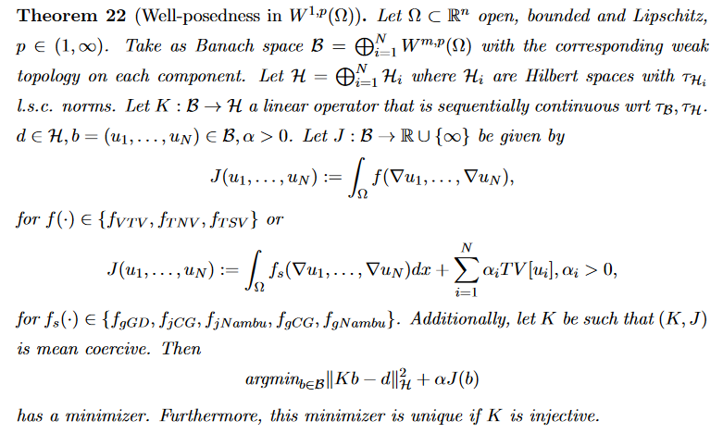

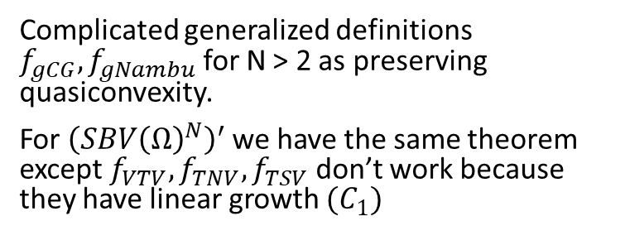


Theoretical Results
$$f_{VTV}=\sum_{i}{σ_{i}{\left(\left[∇u_{1},…,∇u_{N}\right]\right)}^{2}}$$
$$f_{TNV}=\sum_{i}{σ_{i}\left(\left[∇u_{1},…,∇u_{N}\right]\right)}$$
$$f_{TSV}=\max_{i}{σ_{i}}$$
$$f_{gGD}≔\frac{1}{2}\sum_{i=1,…,N}{\sum_{j=1,…,i}{{\left(∇u_{i}−∇u_{j}\right)}^{2}}}$$
$$f_{jCG}≔\frac{1}{2}\sum_{i=1,…,N}{\sum_{j=1,…,i}{{\left|∇u_{i}×∇u_{j}\right|}^{2}}}$$
$$f_{jNambu}≔\frac{1}{2}\sum_{i=1,…,N}{\sum_{j=1,…,i}{\left|∇u_{i}×∇u_{j}\right|}}$$
Complicated generalized definitions $f_{gCG},f_{gNambu}$ for N > 2 as preserving quasiconvexity.
For ${\left(SBV{\left(Ω\right)}^{N}\right)}^{′}$we have the same theorem except $f_{VTV},f_{TNV},f_{TSV}$ don’t work because they have linear growth ${(C}_{1})$

Slide 20
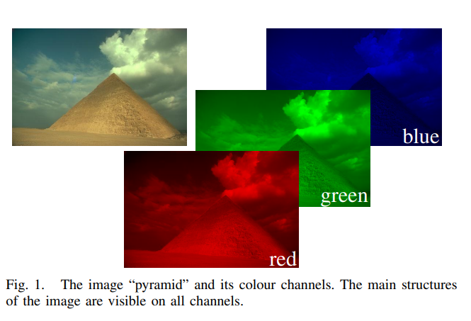
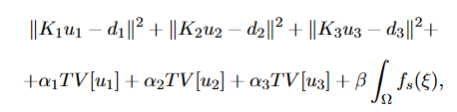
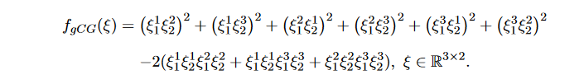
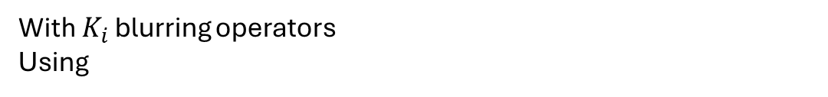
Numerical Testing
General joint inverse problem
Image enhancement: $N = 3, n = 2$
With $K_{i}$ blurring operators
Using
$$f_{s}=f_{gCG}$$

Slide 21
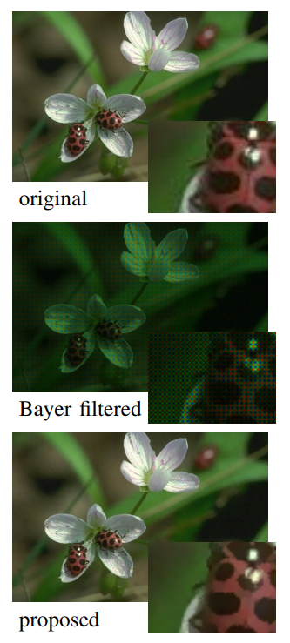
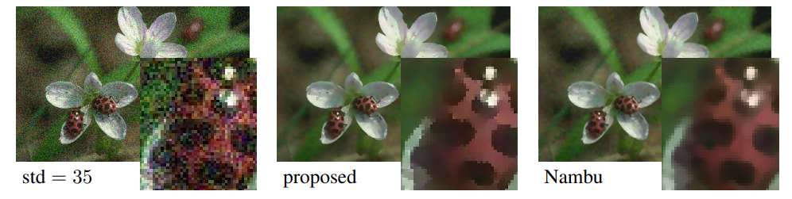


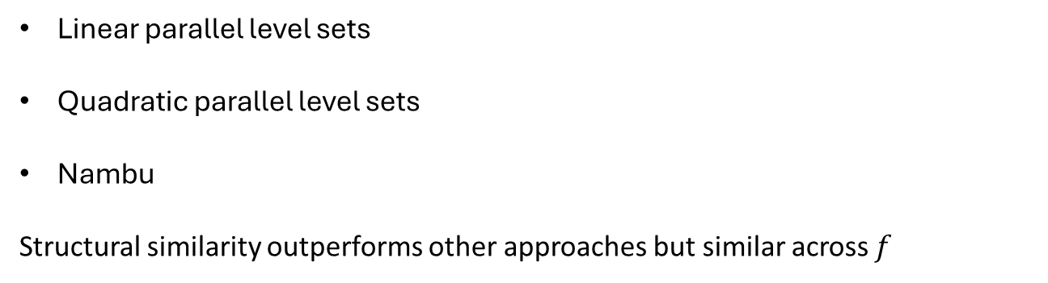

Previous results
[Ehrhardt and Arridge] de-noising and de-moisaicking with “parallel level sets”
Linear parallel level sets
Quadratic parallel level sets
Nambu
Structural similarity outperforms other approaches but similar across $f$
$$f_{LP}=\left|∇u_{1}\right|\left|∇u_{2}\right|−\left(∇u_{1}⋅∇u_{2}\right)$$
$$f_{QP}=\sqrt{1+{\left|∇u_{1}\right|}^{2}{\left|∇u_{2}\right|}^{2}}−{\left(∇u_{1}⋅∇u_{2}\right)}^{2}$$
$$f_{Nambu}=\left|∇u_{1}×∇u_{2}\right|$$

Slide 22

Method
Want to solve
Define new sub-problems
A is TV regularization and a standard convex optimalisation problem: Bregman method
B is continuous and non-convex optimalisation: L-BFGS-B method
Not clear what combination of solving A and B is best

Slide 23

Numerical Results
Algorithm | PSNR | SSIM
A | 20.6 | 0.77
B | 20.6 | 0.76
C | 13.5 | 0.19
D | 21.8 | 0.77
E | 21.7 | 0.79
F | 15.5 | 0.46
G | 15.5 | 0.46
TV | 21.8 | 0.77

Slide 24

Algorithm S
Algorithms E and D first solve sub-problem A then B.
Define a new coercive sub-problem S
S is continuous and non-convex: L-BFGS-B method
Algorithm S: Solve A(u) then S(u)

Slide 25


Numerical Results
Algorithm | PSNR | SSIM
TV | 20.9 | 0.71
S | 22.0 | 0.82
Fixed phantom phenomena in TV.
Noticeable increase visually and quantitatively!
Similar performance across $f_{gCG},f_{gNambu},f_{jCG},f_{jNambu}$
when using best parameters.

Slide 26

Take-aways
In many situations measurements of the same system are performed via different methods.
Mathematically, we can couple these inverse problems via structural similarity with a regularizer that is an integral of type
We need to take care, as the problem is only well-posed for some integrands $f_{s}\left(∇u_{1},…,∇u_{N}\right)$, we can proof or disprove well-posedness via quasiconvexity and growth conditions.
Our deeper understanding of the joint problem provides us with criteria to get well-posed problems for more than 2 different methods ($N > 2$) and any dimensionality ($n ∈N$).
This is not only theoretically relevant, but also works in practice for the new $f_{gCG}$.
$$J\left(u_{1},…,u_{N}\right)≔\int_{Ω}{f_{s}\left(x,u_{1}\left(x\right),…,u_{N}\left(x\right),∇u_{1}\left(x\right),…,∇u_{N}\left(x\right)\right)dx},Ω⊂R^{n}$$

Slide 27
Structural Similarity in inverse problems
Why working together is better.
By: Teun Schilperoort

Slide 28







Joint inversion works!

Slide 29



Slide 30


Slide 31

$$f_{gCG}\left(ξ\right)≔\sum_{β∈I_{\min{\{}N,n\}}^{N}}{\sum_{α∈I_{\min{\{}N,n\}}^{n}}{{\left({\left({\text{adj}}_{\min{\{}N,n\}}ξ\right)}_{α}^{β}\right)}^{2}}}.$$

